Slide 1
CS 211 Computer Architecture Lecture 2: Classes of Computers
Ravi Mittal
ravi.mittal@iitgoa.ac.in
Indian Institute of Technology, Goa

Slide 2
Today’s Thought
You can’t achieve anything in life if
You let your mind to become restless and fragmented
You are unable to concentrate
It’s just a habit of letting your mind wander… drift away..
Try to remain focused in the class for 50 mins without thinking of anything else..

Slide 3
Classes of Computers
Personal Computers
Server Computers
Super Computers
Embedded Computers
Domain Specific Architecture
Personal Mobile Devices
Cloud Computing Architecture
Datacenters

Slide 4
References
Class Presentation, CS61C, Introduction to Assembly Language and RISC-V Instruction Set Architecture, University of Berkeley, Prof Krste Asanović & Randy H. Katz. http://inst.eecs.Berkeley.edu/~cs61c
Computer Organization and Design, The Hardware Software Interface, RISC-V edition, Patterson and Hennessey
Digital Design and Computer Architecture: RISC-V Edition, Harris & Harris Elsevier – Presentation.

Slide 5
Classes of Computers
Personal Computers
General Purpose – variety of software
Runs a variety of applications – millions of them
Doesn’t impose restrictions on development of new applications
Subject to cost/performance tradeoff
What are the design goals of a PC ?
Server Computers
Network based
High capacity, performance, reliability
Range from small to very large
Client – Server based
Chapter 1 — Computer Abstractions and Technology —
Patterson and Hennessy

Slide 6
Classes of Computers
Supercomputers
For high-end scientific and engineering calculations
Highest capability – but small market size
Very expensive – Not much in use excepting for specialized applications
Embedded Computers
Hidden as a component in a system
Significant power/performance/cost constraints
Almost everything today has an embedded processor and Internet connectivity – Car, TV, Fridge, Washing machines, Home security, routers, camera, mobiles, music system, etc
Chapter 1 — Computer Abstractions and Technology —
Patterson and Hennessy

Slide 7
Classes of Computers
Domain Specific Architectures (DSA)
To achieve higher efficiency by tailoring the architecture to characteristics of the domain
Not for one application but for a domain of applications
Requires more domain specific knowledge than what a general purpose processor needs
Chapter 1 — Computer Abstractions and Technology —
Patterson and Hennessy

Slide 8
Client Server Architecture

Slide 9
Domain Specific Architecture
Significant performance improvements cannot occur through improvements in general purpose computing
A very high order of improvements are possible only by domain specific hardware acceleration
Example:
TPU (Tensor Processing Unit) Architecture – by Google
Neural network for machine learning
GPUs for virtual reality
Programmable network switches and interfaces
Advantages:
Eliminates unneeded activities
Uses domain specific parallelism effectively
Use of domain specific languages; Hardware/Software/System designed for a specific domain

Slide 10
Client Server Architecture
Server – Receives and processes requests from clients
It hosts, delivers and manages the resources and services to be consumed by clients
Client – Sends requests to the server for a specific service
Load Balancer – responsible for distributing incoming network traffic across a group of backend servers to optimize resource usage
Network Protocols - TCP/IP, UDP
Not a peer-to-peer architecture

Slide 11
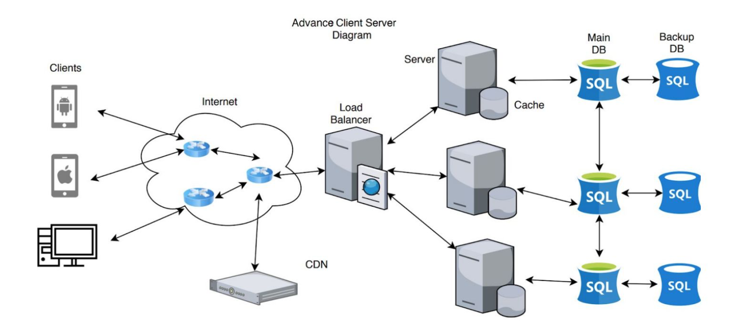
An Example of Client-Server Architecture
CDN: Content Delivery Network

Slide 12
Domain Specific Architecture

Slide 13
Domain Specific Architecture
Significant performance improvements cannot occur through improvements in general purpose computing
A very high order of improvements are possible only by domain specific hardware acceleration
Advantages:
Eliminates unneeded activities
Uses domain specific parallelism effectively
Use of domain specific languages; Hardware/Software/System designed for a specific domain

Slide 14
Domain Specific Architecture
Example:
TPU (Tensor Processing Unit) Architecture – by Google
ASIC for Deep Neural Net
Programming: TensorFlow
Neural network for machine learning
GPUs for virtual reality
Programmable network switches and interfaces
Catapult, Microsoft
Architecture that allows new ways of using interconnected FPGAs as computational accelerators
Crest, Intel
Use of parallelism that matches the target domain
Use of domain specific language

Slide 15
PostPC Era

Slide 16
The PostPC Era
Personal Mobile Device (PMD)
Battery operated
Connects to the Internet
Hundreds of dollars
Smart phones, tablets, electronic glasses
Cloud computing
Warehouse Scale Computers (WSC)
Software as a Service (SaaS)
Portion of software run on a PMD and a portion run in the Cloud
Amazon and Google
Data Center
100000+ servers tightly interconnected – within a premise – with tons of storage capacity
To run a complex application – eg Google Query – that requires thousands of processors
Chapter 1 — Computer Abstractions and Technology — Patterson and Hennessy

Slide 17
Mobile

Slide 18
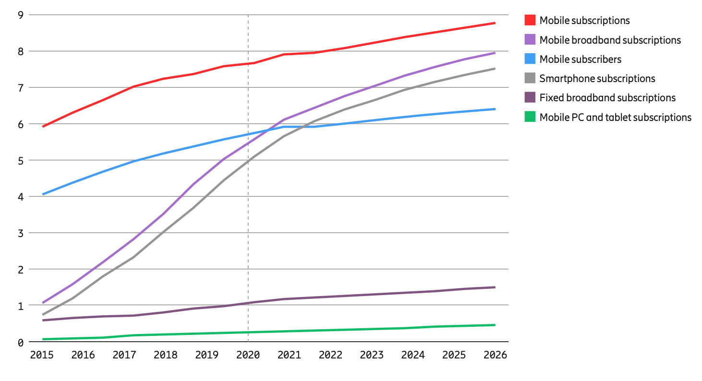
Mobile Subscriptions and subscribers (billion)
In beginning 2021, there are around 7.9 billion mobile subscriptions and
6.1 billion smartphone subscriptions
Ref: Ericsson Mobility Report, Nov 2020, Mobile Subscription Outlook

Slide 19
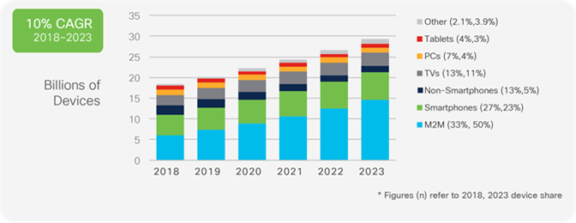
Global Devices and Connection Growth
Source: Cisco Annual Internet Report, 2018–2023

Slide 20
Cloud Computing and Datacenter Architecture

Slide 21
Cloud Computing
On-demand
Use resources when you need it; pay-as-you-go
Elastic
Scale up and down based on demand
Multi-tenancy
Multiple independent users share infrastructure
Security and resource isolation
SLAs on performance and reliability (sometimes)
Dynamic Management
Resiliency: isolate failure of servers and storage
Workload movement: move work to other locations

Slide 22
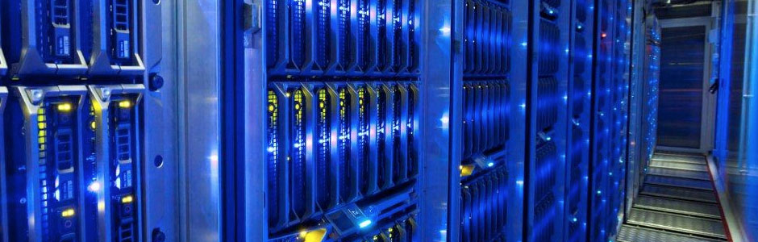
What are Data Centers?
Large facilities with 10s of thousands of networked servers
Compute, storage, and networking working in concert
“Warehouse-Scale Computers”
Notes:
Datacenters are large facilities that house tens of thousands of networked servers. These facilities are typically owned by businesses or government organizations and require huge investments to build and operate. Just to give you an idea: a large datacenter that a company like Google or Microsoft might build…
There are different kinds of datacenters: There are specialized datacenters which support a particular application….
There are also cloud datacenters which are more general purpose infrastructure

Slide 23
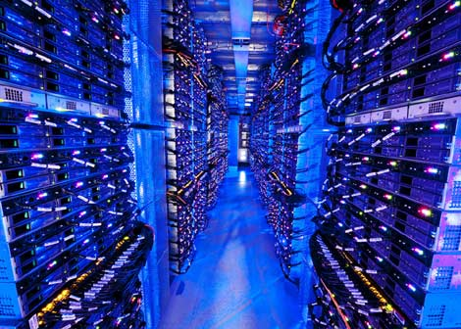
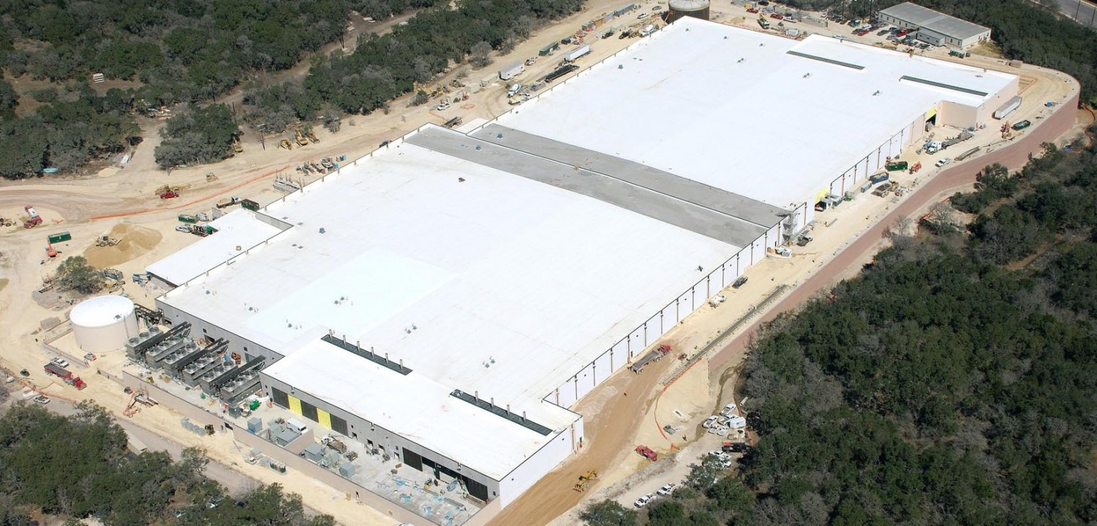
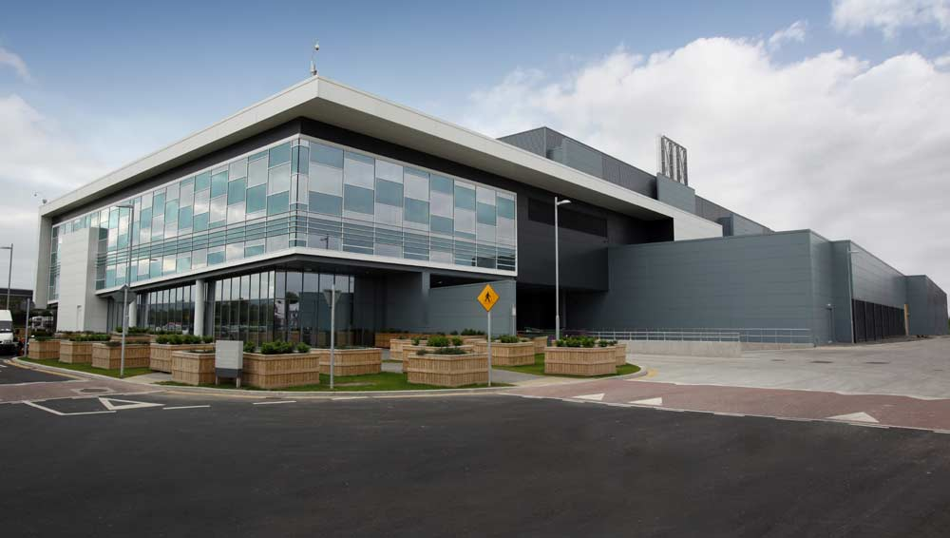
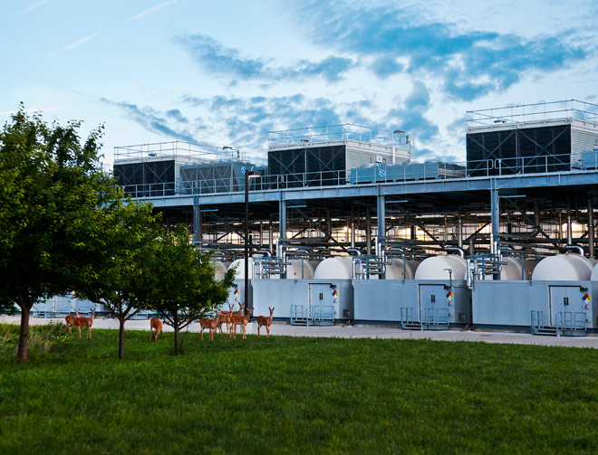
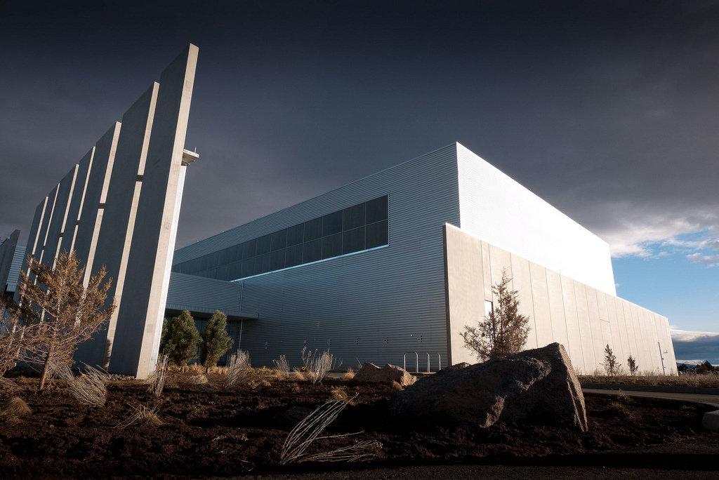
Data Centers with 100,000+ Servers
Microsoft
Microsoft
Google
Facebook

Slide 24
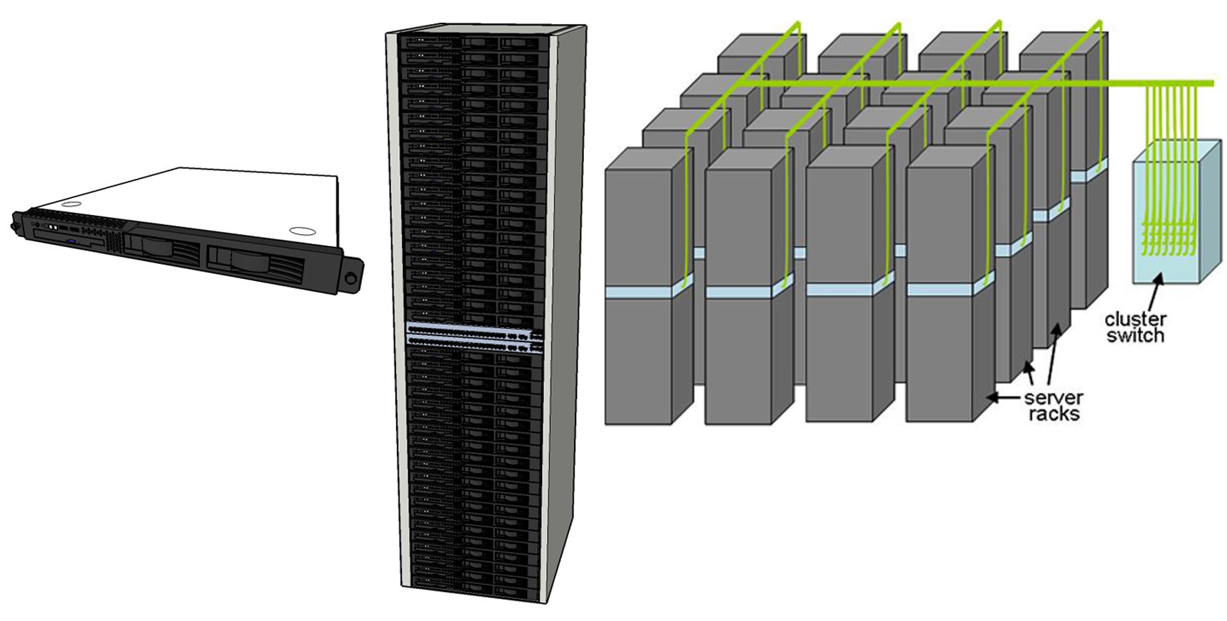
Warehouse-Scale Data Center Building Blocks
.
Typical elements in warehouse-scale systems: 1 server (left), 7´ rack with Ethernet
switch (middle), and diagram of a small cluster with a cluster-level Ethernet switch/router (right).

Slide 25
Internet of Things

Slide 26
Everything is becoming smart
Earlier things had computers in them
Now, computers have things attached to them
Computers are becoming smaller, cheaper, and more powerful. Internet connectivity is almost free
Manufactures are making everything smart
Do you notice that you are buying computers with things attached to them?
If not, start doing it now

Slide 27
The IoT
Extending the current Internet and providing connection, communication, and inter-networking between devices and physical objects, or "Things," is a growing trend that is often referred to as the Internet of Things
“The technologies and solutions that enable integration of real world data and services into the current information networking technologies are often described under the umbrella term of the Internet of Things (IoT)”

Slide 28
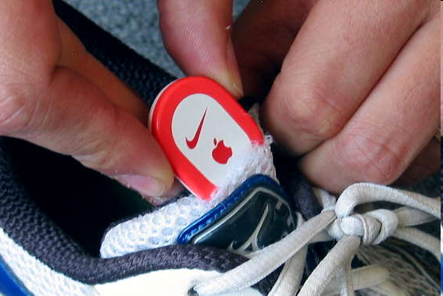
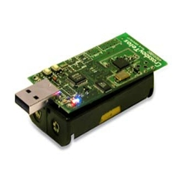
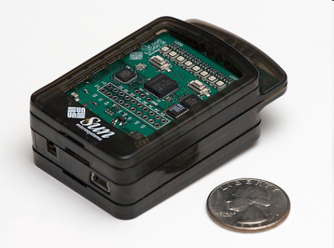
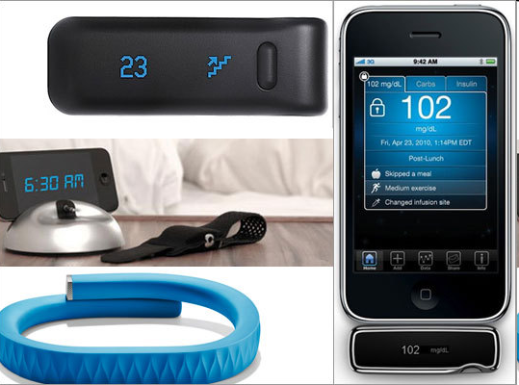
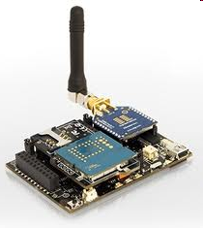
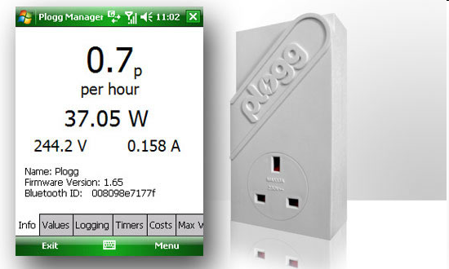
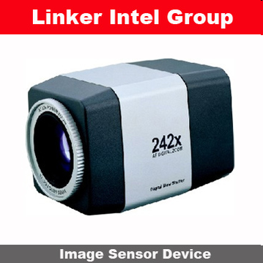
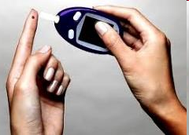
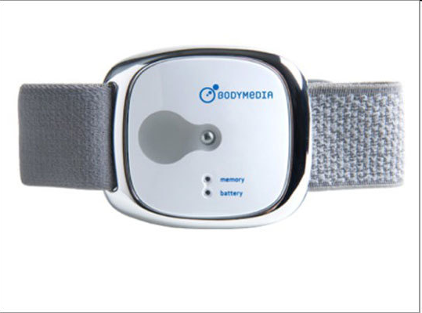
Sensor devices are becoming widely available
- Programmable devices
- Off-the-shelf gadgets/tools

Slide 29
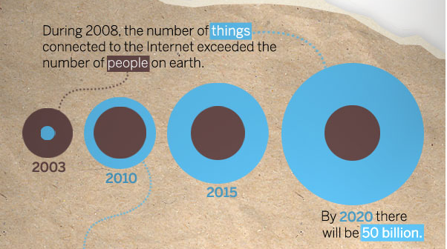
“Thing” connected to the internet
Source: CISCO
29

Slide 30
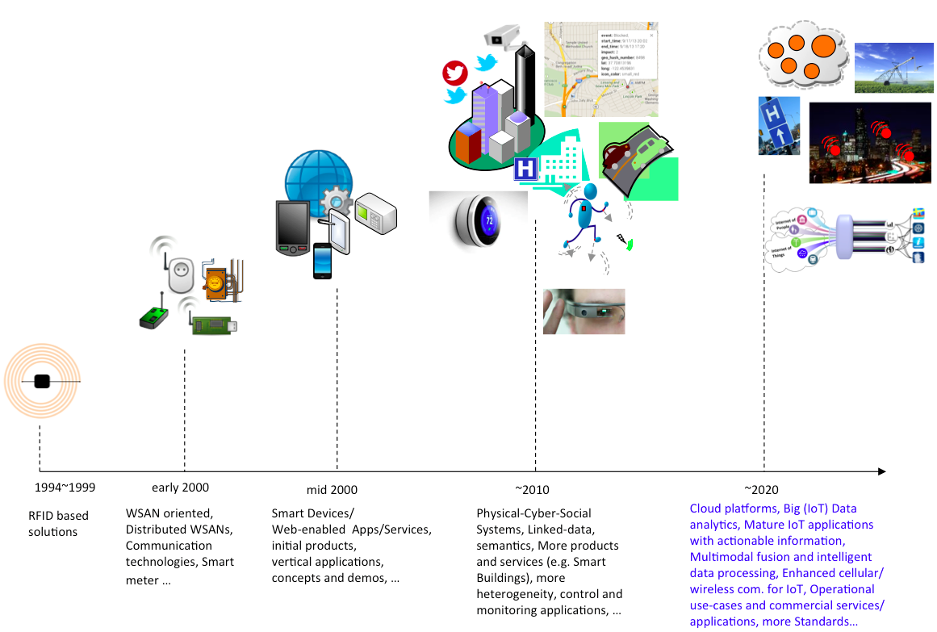
Internet of Things
WSAN: Wireless Sensors and Actors Networks
P. Barnaghi, A. Sheth, “Internet of Things, The story so far”, IEEE IoT Newsletter, September 2014.

Slide 31
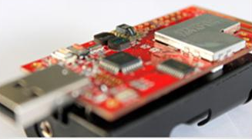
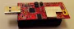
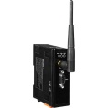

IoT Platform
IEEE 802.15.4 2.4GHz RF System
User/Environment
2 sensors
“Thing”
Sensors & Actuators
XM1000
Device level
Communications
Network
Gateway
The Internet
Network level
The Internet
Servers

Slide 32
Class - Summary
PrePC Era Computers:
PC, Servers, Super computers, Embedded computer
PostPC Era Computers:
Domain Specific Architectures
Mobile, iPad/Slate/Tablet
Data Centers
Cloud
IoT

Slide 33
Backup
CS 305: Computer Architecture

Slide 34
Inside an iPad/Computer

Slide 35
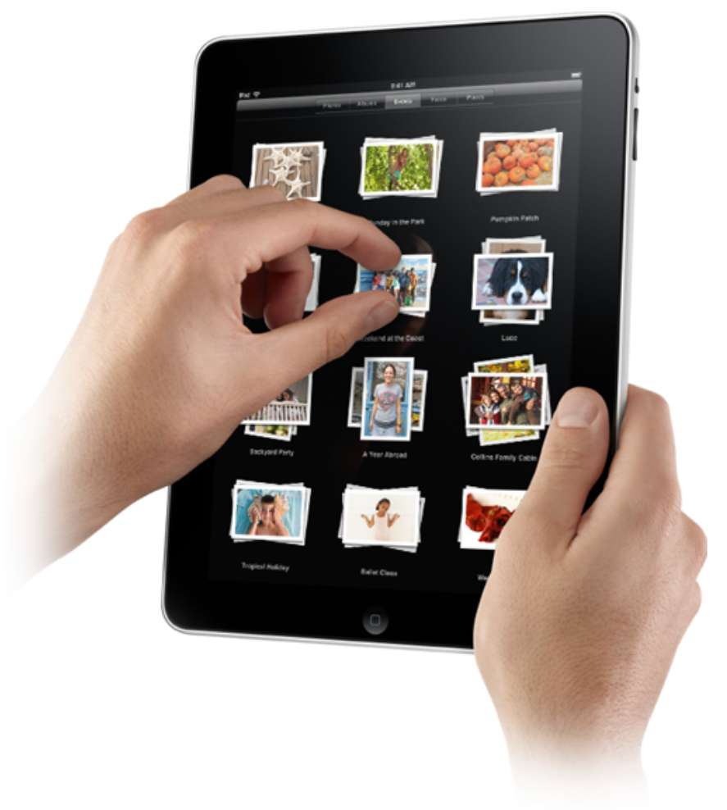
Touchscreen
PostPC device
Supersedes keyboard and mouse
Resistive and Capacitive types
Most tablets, smart phones use capacitive
Capacitive allows multiple touches simultaneously
Chapter 1 — Computer Abstractions and Technology — Patterson and Hennessy

Slide 36
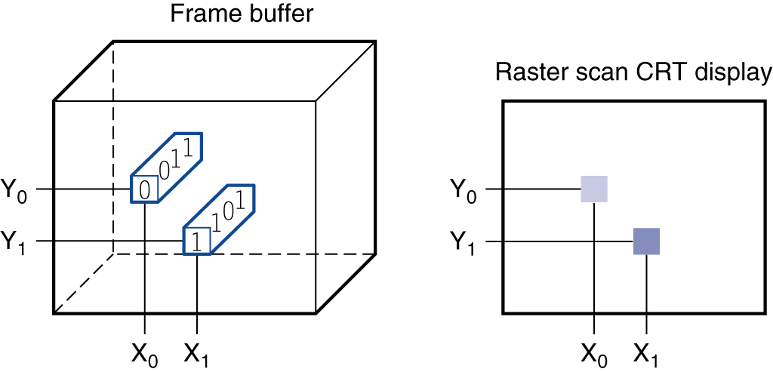
Through the Looking Glass
LCD screen: picture elements (pixels)
Mirrors content of frame buffer memory
Chapter 1 — Computer Abstractions and Technology — Patterson and Hennessy
Notes:
liquid crystal display
A display technology using a thin layer of liquid polymers that can be used to transmit or block light according to whether a charge is applied.
Today, most LCD displays use an active matrix that has a tiny transistor switch at each pixel to precisely control current and make sharper images. A red-green-blue mask associated with each dot on the display determines the intensity of the three- color components in the final image; in a color active matrix LCD, there are three transistor switches at each point.
pixel The smallest individual picture element. Screens are composed of hundreds of thousands to millions of pixels, organized in a matrix.
The image is composed of a matrix of picture elements, or pixels, which can be represented as a matrix of bits, called a bit map. Depending on the size of the screen and the resolution, the display matrix in a typical tablet ranges in size from 1024 * 768 to 2048 * 1536. A color display might use 8 bits for each of the three colors (red, blue, and green), for 24 bits per pixel, permitting millions of different colors to be displayed.
The computer hardware support for graphics consists mainly of a raster refresh buffer, or frame buffer, to store the bit map. The image to be represented onscreen is stored in the frame buffer, and the bit pattern per pixel is read out to the graphics display at the refresh rate.

Slide 37
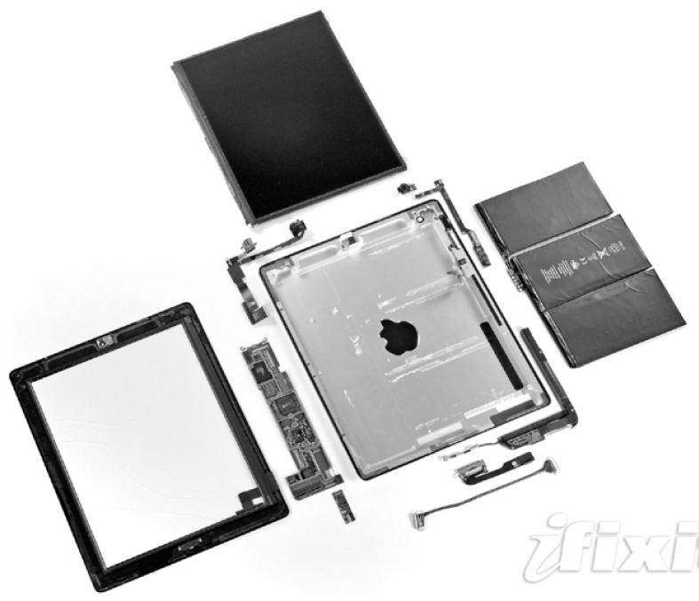
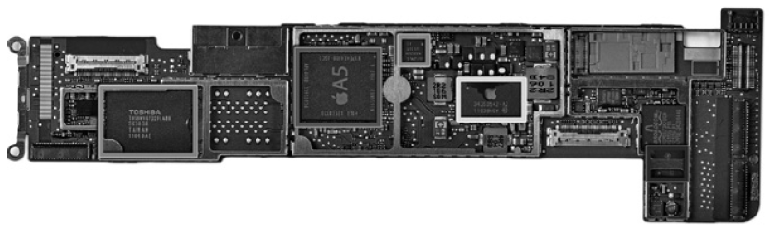
Opening the Box - iPad2
Capacitive multitouch LCD screen
3.8 V, 25 Watt-hour battery
Computer board

Slide 38
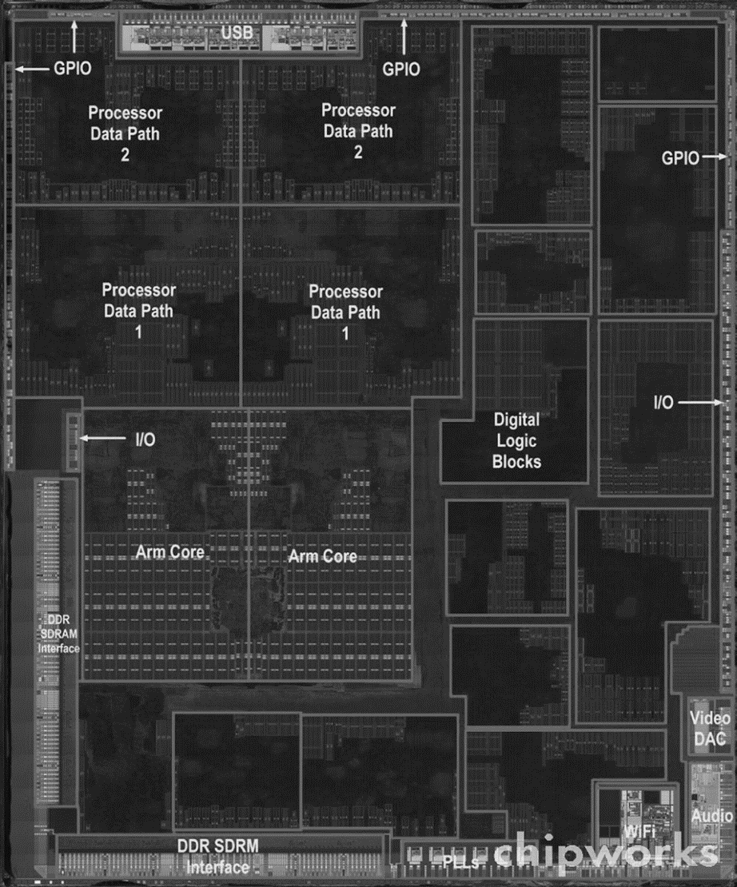
Inside the Processor
Apple A5
Chapter 1 — Computer Abstractions and Technology — Patterson and Hennessy

Slide 39
I/O Devices of iPad
Capacitive multitouch LCD display
Front facing camera
Rear facing camera
Microphone
Speaker
Headphone jack
Accelerometer
Gyroscope
WiFi network
Bluetooth network
Chapter 1 — Computer Abstractions and Technology — Patterson and Hennessy
Notes:
Gyroscope – A gyroscope is a device that uses Earth's gravity to help determine orientation.
An accelerometer is a compact device designed to measure non-gravitational acceleration.

Slide 40
Other components
Microprocessor
Datapath – Performs arithmetic logical operations
Control – tells datapath, memory, and I/O devices what to do according to the instruction
Memory chips
DRAM: Dynamic Random Access Memory
Cache Memory
Made using SRAM: Static Random Access Memory – small and fast for immediate access of data
Non-volatile Flash Memory
Chapter 1 — Computer Abstractions and Technology — Patterson and Hennessy

Slide 41
CDN Architecture
Internet core
Users
CDN nodes
Content providers
CDNs excel at delivering static content
Moves data closer to end-users
Decreases latency and increases throughput
Notes:
Note that the CDN solution may easily move the web server and application server to edge proxy nodes, but the centralized database server quickly becomes a performance bottleneck

Slide 42
IC Manufacturing

Slide 43
Memory and I/O Technology Trends
DRAM density increases by 40-60% per year, latency has reduced by 33% in 10 years (the memory wall!), bandwidth improves twice as fast as latency decreases
Disk density improves by 100% every year, latency improvement similar to DRAM
Networks: primary focus on bandwidth; 10Mb → 100Mb in 10 years; 100Mb → 1Gb in 5 years

Slide 44
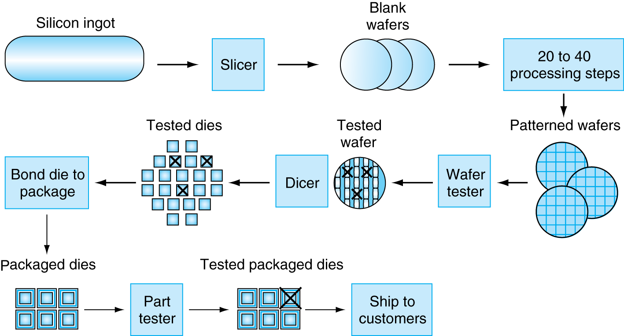
Manufacturing ICs
Yield: proportion of working dies per wafer
Chapter 1 — Computer Abstractions and Technology — Patterson and Hennessy

Slide 45
Manufacturing ICs
Giant Silicon Ingot
8-12 inches in diameter and 12-14 inches long
Sliced into wafers – less than 0.1 inches thick
Wafer → Series of processing steps as patterns of chemicals are placed on each wafer → creates transistor, conductor, and insulators
One layer of transistor but 2 to 8 levels of metal conductor separated by layers of insulators
Patterned wafer is diced into dies or chips
Chapter 1 — Computer Abstractions and Technology — Patterson and Hennessy

Slide 46
Trends
Die size increases by 10-20% per year… functionality improvements
Wire delays do not scale down at the same rate as transistor delays
Chapter 1 — Computer Abstractions and Technology — Patterson and Hennessy

Slide 47
Manufacturing Process
Silicon wafers undergo many processing steps so that different parts of the wafer behave as insulators, conductors, and transistors (switches)
Multiple metal layers on the silicon enable connections between transistors
The wafer is chopped into many dies – the size of the die determines yield and cost
Chapter 1 — Computer Abstractions and Technology — Patterson and Hennessy

Slide 48
Self study
If you are asked to design a mobile handset, what will be the main design requirements?
What is the difference between Cloud and Data Center ?
What are the reasons for popularity of Cloud computing?
What is the difference between Synchronous and Asynchronous circuits?
Whatever device you use, find out how it works
For example, yesterday, I have

Slide 49
Self Study
Be a smart computer Engineer
Whatever device you use – learn about it’s functioning, it’s components, trends etc
For example, today, I have got 100 Mbps Broadband connection. I need to find out
What technology it uses eg Fiber to home ?
What kind of fiber it uses ?
What is backend router for Airtel – which connects multiple homes over fiber?
What is the capacity of the router airtel has provided at home?
What is the security mechanism? Do I need to do anything apart from setting device password?
How do I set up password for SSID?
What is the range of the WiFi signal ? How do I get strong signal in my study room – which is two rooms away?

Slide 50
Self Study
How can I extend range of WiFi router?
Do I need to buy Mesh WiFi system?
What is Mesh WiFi system?
How do I setup firewall of WiFi router?
What WiFi stack is currently in use?
How does WiFi work ? What are the protocols?
What is the speed of Ethernet (cable) port?
What is the Ethernet port speed on the router?

